Slide 1


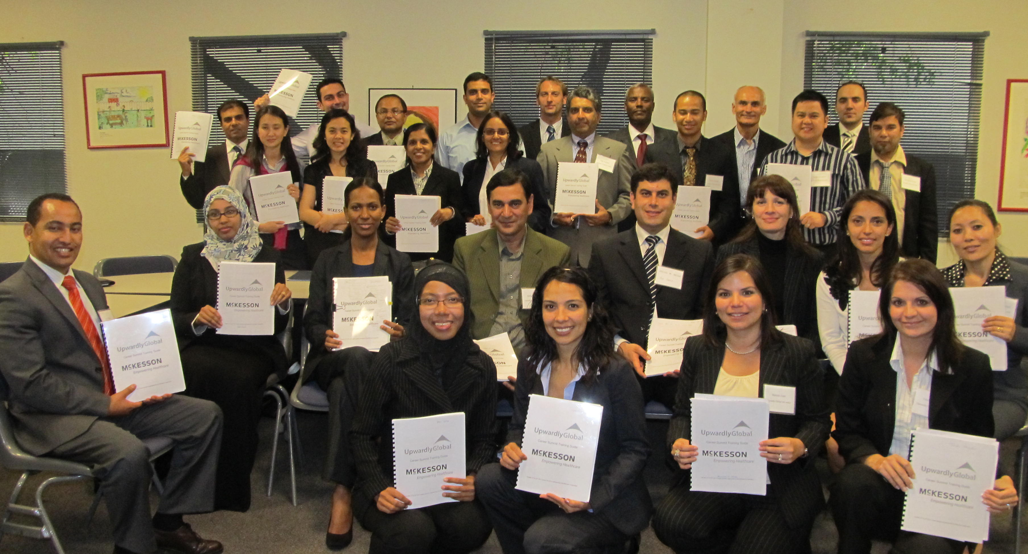
Upwardly Global Overview
Nikki Williams
Program Manager
Upwardly Global – New York
nikkig@upwardlyglobal.org

Slide 2
Upwardly Global Overview
  Mission:
  To eliminate barriers for skilled immigrants and refugees and to integrate this population into the professional U.S. workforce.
    Vision:
    A United States where skilled immigrants are seamlessly integrated into the professional workforce and the fabric of American life, and are recognized for the value they add to both.

Slide 3
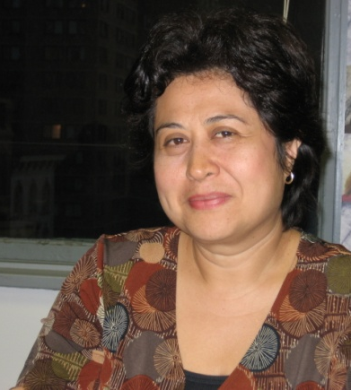

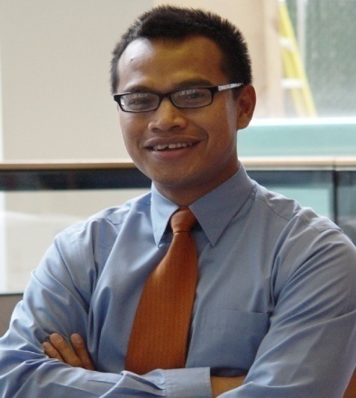

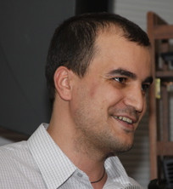
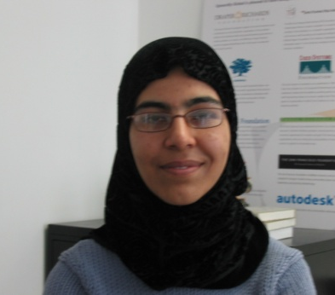
Why Does Upwardly Global Exist?
Evelyn
El Salvador
Engineer
Graal
Brazil
Arts Therapist
Housecleaner
Waitress
Waspada
Indonesia
Auditor
Faith
Kenya
Social Worker
Barista
Nanny
Manizha
Afghanistan
Physician
Cristian
Romania
Engineer
Cashier
Taxi Driver
Notes:
A survey by MPI revealed that more than 1.3 million college-educated immigrants are unemployed or working in unskilled jobs
21% of all college-educated immigrants (or 1 out of every 5 skilled immigrants) are working in unskilled jobs
Another 22% of immigrants are in semi-skilled jobs – carpenters, electricians, massage therapists, etc.
Brain waste is a reality

Slide 4
Our Talent at a Glance
Global
All our candidates have international work experience &
global professional networks.
Work Authorized
Have full legal authorization to work in the U.S.
No need for employment or visa sponsorship.
Industry Specialized
Average of seven years experience;
more than 50% have management experience.
Upwardly Global Talent
Diverse
Are bilingual, speaking English and their native language(s)
and represent more than 94 countries.
Educated
100% completed a BA/BS (or equivalent);
50% have A Master’s degree.
Notes:
*Focus on the “Fully work authorized”*. Job Seekers come to US through family reunification, greencard lottery or as asylee/refugee
Most people learn about UpGlo through word of mouth

Slide 5
Barriers to Career Re-entry
Social & Financial
Unfamiliarity with U.S. job search processes and cultural norms.
Lack of U.S. professional and social networks.
Targeting wrong positions and/or employers.
Immediate financial needs complicate long-term planning.
Employer
Prefer local work experience; fear hires will be expensive and time consuming to acculturate, check international references, etc.
Academic credentials and professional skills/experience are not recognized.
Misconceptions about sponsorship & English proficiency.
Technical
Relicensing and certification (complicated, costly, & time consuming).
Language skills may need to improve depending on field.
Notes:
Resume: picture, date of birth, 5-pages to be credible
Interview: China- inappropriate to ask questions, firm hand shake, seen as boasting to talk about INDIVIDUAL experience
Follow-up: US appreciates polite persistent follow-up

Slide 6

Filling the U.S. Skills Gap
Notes:
Upwardly Global is filling skills gaps in the U.S. and therefore having on overall positive impact on our economy.
Here is an info graphic showing which industries UpGlo job seekers are coming from. You can see from this slide that our placements align with the need in our economy – heavy in science and engineering, IT, accounting and finance. We also place many employees in global companies who need cross-cultural business skills and language skills to help them do business around the world.

Slide 7
Upwardly Global’s Approach
Training:
  Resumes
  Cover Letters
  Networking
  Interviewing
Individual Coaching
Volunteer Engagement
Employer Network
Job Seeker Programs
Impact
Social & Economic Impact
Influence
Candidate Referrals
Volunteering
Education
Advocacy
Mentors
Mock Interviewers
Industry experts
Connectors

Slide 8
Corporate Employee Engagement
Skills-based Volunteer Opportunities
Mock/Informational Interviews
Emulates a real interview for 15-20 job seekers paired with 15-20 volunteers
Time commitment: 1.5 – 3 hours
Candidates build confidence and improve interviewing techniques
Volunteers provide valuable coaching, real-time feedback and develop leadership skills
Industry Roundtable
Roundtables feature 15 to 25 job seekers, a panel of 3-4 volunteers
Time Commitment: 1.5 hours
Panelists discuss hard and soft industry skills that US employers value and job search strategies within specialized sectors
Leadership Panel
3-4 high level volunteers, 20-30 job seekers
Time Commitment: 2 hours
Features executives, their path to success and leadership
Q&A
Career Summit
3 day intensive training program customized skilled immigrant job seekers
Time commitment: 3 hours (or more depending on participation each day)

Slide 9
Corporate Partnership Benefits
Corporate Social Responsibility | Employee Development | Diversity Recruiting
We align our core programs needs and our skills-based volunteer opportunities to our partners’ internal social service and civic causes goals to ensure the highest impact to our communities Our collaborative work demonstrates our partners commitment to build a diverse and global workforce Our cooperation creates marketing and branding opportunities for our partner companies | Our Employee Engagement initiatives offer real-time learning & development opportunities for the following skills: a) Leadership b) Cross-cultural Communication c) Coaching d) Mentoring e) Training Our skills-based volunteer opportunities allow our partners to develop high potential employees | Our multi-faceted relationship creates an inclusive recruiting environment where our partners’ employees actively contribute to their diversity hiring needs Our partners have access to a pipeline of international talent with global business acumen
Notes:
Who are your current partners
What projects are you currently collaborating with them
What values do you see in those partnership
How can we become a valuable partner

Slide 10
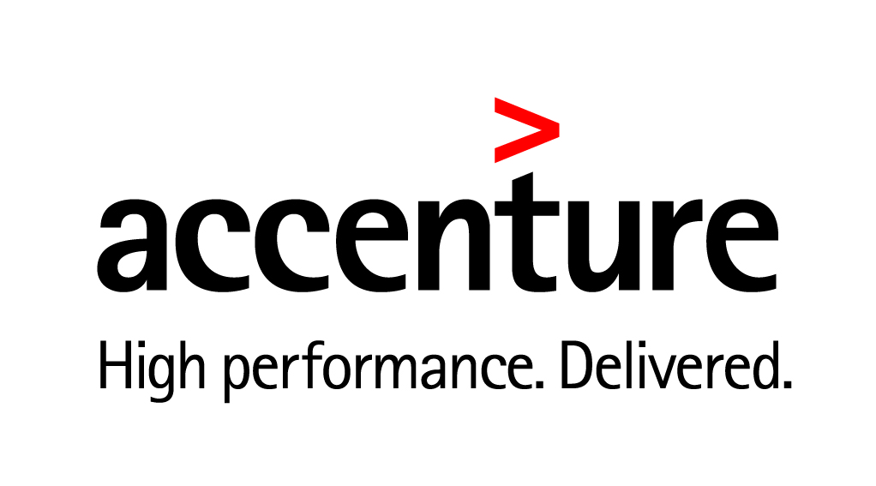









Our Partners at a Glance
Notes:
On a national level, work with 600 employers that range in size from small medium enterprises to Fortune 15 companies.
We work with a variety of people inside corporations and institutions. On the program side we source candidates to recruiters and hiring managers
On the business side we partner with different lines of business including Human Resources, Diversity, corporate foundation and corporate social responsibility leads.
In NYC, for example, we have placed 4 people at Small Business Services, and 2 people at the New York City Housing Authority; there is also 1 more former jobseeker awaiting a contract at NYCHA.

Slide 11
Job Seeker Services Program
1
Applicants complete online application and participate in trial call
2
Accepted participants attend group orientation and complete online resume workshop
3
Complete training
(3-Day Summit, 5-Week Cohort, Online, or mix)
4
1-on-1 coaching: job search; presents to employers, referrals for degree evaluation, mentor intros; & licensing/job pathway advice
5
Placements receive assistance negotiating salary offers/contracts and are invited to join the UpGlo Alumni Network
Notes:
Pathways: Physicians (clinical researchers, surgical skills for tissue transplantation)
6-18 months, 50% placed into jobs
Eligibility Requirements
Arrived in U.S. within the past 5 years
Full, permanent work authorization (Green Card or I-94 with Asylee or Refugee status)
Minimum of a BA degree from outside the U.S.
At least 2 years Professional work experience in home country
Job seekers must speak English well enough to work in their field in the U.S.
Proficient with computers
Commitment to their job search and completing all required workshops

Slide 12
UpGlo by the Numbers: National
In the U.S., there are 1.3 million work-authorized, experienced, and educated immigrants who are either unemployed or underemployed (Migration Policy Institute).
To date, UpGlo has coached 5,000 skilled immigrants and directly assisted over 2,000 professionals back into their career field with more than $250M in direct economic impact.
UpGlo provides training on the U.S. job search, resume development, cover letter writing, and interview and networking practice to more than 1,300 skilled immigrants annually.
UpGlo has a network of more than 500 employer partners including Fortune 1000 companies, nonprofits and public sector.

Slide 13
UpGlo by the Numbers: New York
Since the New York office launched in 2006, we have trained more than 2,000 skilled immigrants from 100 countries.
Placed more than 803 skilled immigrants with an average starting salary of $41,000 with benefits.
At least 80% of placements are still professionally employed one year later.
Engage 85 employers annually and maintain 600 NY volunteers as partners to work towards systemic change.
Partnerships with close to 100 community organizations.

Slide 14
Recap: Immigrant Workforce Integration
Upwardly Global
US Economy and Society
Employers
Skilled Immigrants
Matching Skilled Immigrants with Employer Talent Needs
Employers:
Need highly skilled, diverse professionals to stay ahead of demographic changes in the workforce
Want to reduce effort and cost for attracting, hiring, and retaining new talent
Are looking for cost-effective ways to build employee skills and increase retention and engagement
Job seekers:
Are highly-skilled and motivated
Lack professional networks and familiarity with the U.S. job application culture
Need coaching from U.S. professionals to help them understand how to meet the expectations of American employers
*There are currently more than 3 million job openings in the U.S. that are often left unfilled due to the lack of qualified workers
(U.S. News & World Report)
Notes:
At any point in time there are 2.7 million skilled immigrants who are either unemployed or working in low-skill jobs far below their education and experience.
Upwardly Global’s work is all about matching these talented job seekers with employers who need global talent to be able to compete both locally and internationally.
We are still in a recovering economy and unemployment remains unacceptably high, but at the same time there is a critical talent gap in America today, with 3 million open positions that employers are finding hard to fill. 49% of employers surveyed by Manpower in 2012 had delays in filling mission critical positions at their companies because of a lack of suitably qualified applicants.
These positions call for skills and experience that employers say they cannot find in our domestic workforce. For example, they need STEM professionals with science, engineering, math and technology backgrounds and skilled immigrants particularly from developing countries like India, China and Russia are a great fit for these roles.
The good news is that Upwardly Global has already been able to find a way to help more than 1500 job seekers get their first professional jobs in America. Last year 75% of our job seekers were unemployed when they joined our program and the remainder earned less than $20,000 per year. After completing our program they secured jobs with an average starting salary of $50,000 . Typically 9 out of 10 of those placed are still in their employment at the end of 12 months and, in fact, go on to secure further salary raises and promotions. So we’re not only helping these individuals and families rebuild their lives but we also help employers fill key talent gaps. Our work has directly resulted in $118m in additional income generated for immigrant families and their communities.
Now we want to scale our work to reach thousands, hundreds of thousands and ultimately 2.7 million skilled immigrants

Slide 15
Thank You!
Contact Information:
Nikki Williams, Program Manager
212-219-8828 x. 205
nikkig@upwardlyglobal.org

