Slide 1
Presentation to the Copenhagen Delegation
October 4, 2014
Overview of New York City’s Labor Market and Workforce System
Lesley Hirsch
Director, New York City Labor Market Information Service
City University of New York Graduate Center

Slide 2
City University of New York
Serves over 500,000 degree and continuing education students
24 colleges on 17 campuses citywide
Current foreign-born undergraduates harken from 135 countries
Tradition of partnerships with K-12 schools, economic development initiatives, immigration and financial advice services, and other community outreach.

Slide 3
New York City Labor Market Information Service (NYCLMIS)
Began in 2008 as a joint initiative of the New York City Workforce Investment Board and the City University of New York and is housed at the CUNY Graduate Center.
We have become the go-to place for timely, action-oriented intelligence about New York City’s labor market. We conduct research studies, provides training and strategic consultation, and hold forums that raise awareness of work-related issues.
The researchers, industry experts, and policy professionals that staff NYCLMIS help education and workforce development practitioners and policy makers make informed decisions so that they can help jobseekers to achieve success in the labor market.

Slide 5
Comparison of the labor supply, US and New York City
 | United States | New York City
Poverty | 14.9% | 19.9%
Race/ethnicity
Asian | 6% | 13%
Black | 13% | 26%
Hispanic | 17% | 29%
White | 66% | 33%
Foreign born | 13% | 37%
Speak other language at home and speak English less than “very well” | 9% | 23%
Educational attainment
Less than high school | 12% | 21%
High school or equivalent | 30% | 25%
Some college or Associate | 27% | 21%
Bachelor’s or more | 32% | 34%
SOURCE | American Community Survey. For New York City, 2008-2012 combined sample; for the US, 2013.

Slide 6
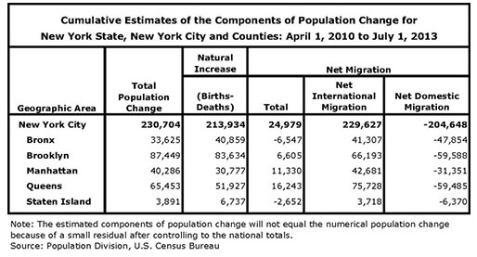
New York City’s Population Churn

Slide 7
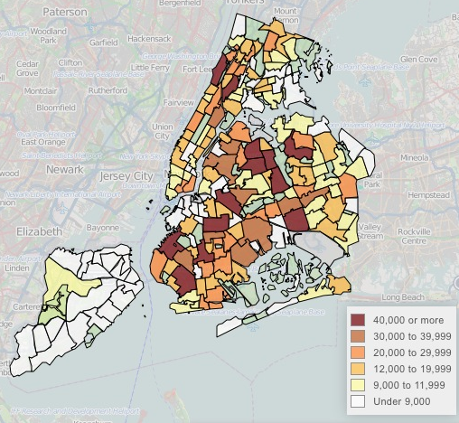
Where New York City’s Immigrants Livehttp://www.nyc.gov/html/dcp/html/census/nny.shtml

Slide 8
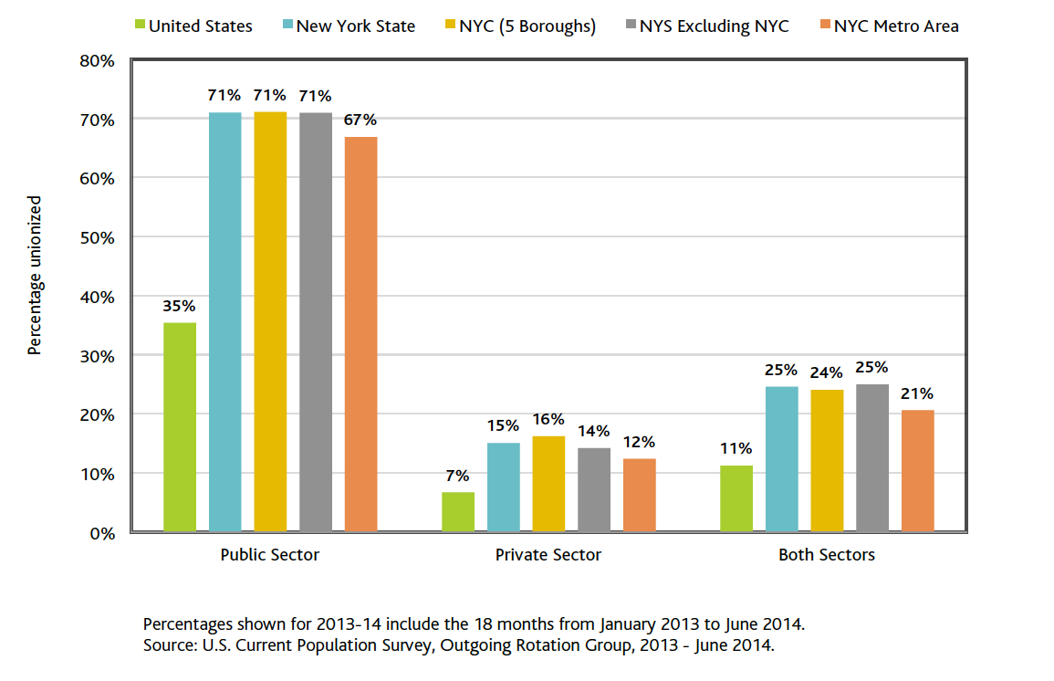
Union Density by Sector, the US, New York State,
New York City, and the Metro Area

Slide 9
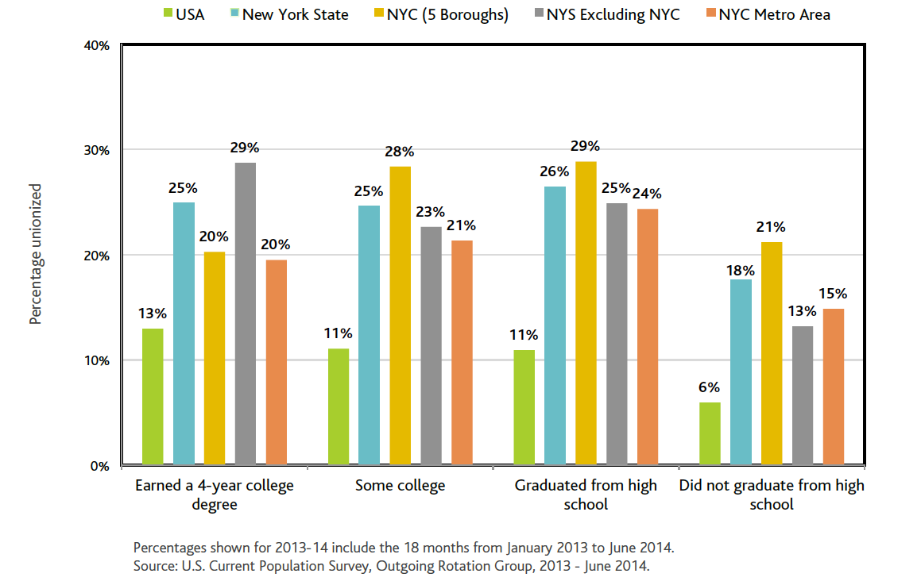
Union Density by Educational Attainment in the US, New York State,
New York City, and the Metro Area

Slide 10
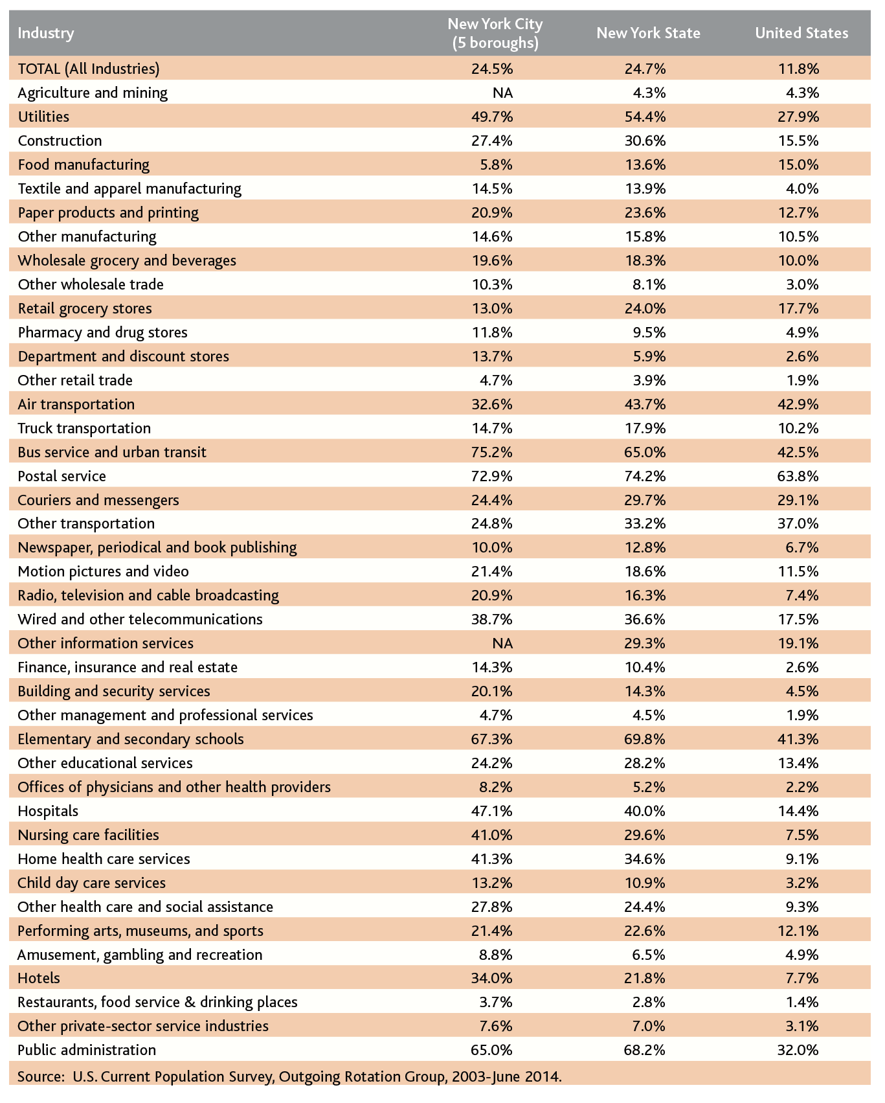
Union Density by Industry, New York City, New York State and the US

Slide 11
Union Density by Industry, New York City, New York State and the US

Slide 14
SOURCE | NYSDOL, Current Employment Statistics

Slide 15
SOURCE | NYSDOL, Current Employment Statistics

Slide 17
Notes:
-29% Accommodation and Food Services
-57% Real Estate Rental and Leasing
-22% Other Services (except Public Administration)
-21% Health Care and Social Assistance
-27% Administrative and Support and Waste Management and Remediation Services
-39% Manufacturing -28% Transportation and Warehousing
-12% Educational Services
-13% Retail Trade
-34% Arts, Entertainment, and Recreation
-22% Public Administration
-25% Construction
-16% Wholesale Trade
6% Professional, Scientific, and Technical Services
7% Information
1% Management of Companies and Enterprises
52% Finance and Insurance

Slide 18
Measures of Labor Under-Utilization, the US and New York City*
 | United States | New York City
Unemployed** 15 weeks or longer | 3.5% | 5.6%
Job losers, or completed temporary assignment | 3.5% | 4.6%
Total unemployed | 6.8* | 8.3%
Total unemployed, plus discouraged | 7.2% | 9.0%
Total unemployed, plus marginally attached*** | 8.1% | 10.0%
Total unemployed, plus marginally attached and working part-time for economic reasons | 12.9% | 14.6%
*Expressed as a percent of the civilian labor force
**Not employed and looking for work in the past four weeks
***Includes the discouraged
SOURCE | Bureau of Labor Statistics, Current Population Survey, July 2013 through June 2014

Slide 21
City Workforce System’s “Alphabet Soup”
Administration for Children’s Services
Center for Economic Opportunity
City University of New York
Department for the Aging
Department of Corrections
Department of Probation
Department of Small Business Services
Department of Youth and Community Development
Human Resources Administration
Mayor’s Office of Immigrant Affairs
Mayor’s Office of Adult Education
New York City Housing Authority
And hundreds of private sector “third-party” providers

Slide 22
Free and Low-Cost Services for Immigrants
School system navigation services
Free legal assistance related to immigration status (including CUNY’s Citizenship Now! Program)
Services for victims of domestic violence and trafficking
Employment rights services for immigrant workers
Legal services for immigrant youth
Deferred Action for Childhood Arrivals (DACA)
Naturalization test preparation
Financial empowerment promotoras program
ACCESSNYC, multilingual program to assess eligibility for public benefits
Refugee health screening and healthcare services
We Are New York television series for immigrant New Yorkers
Center for Immigrant Education and Training at La Guardia Community College
And more services from the State of New York Bureau of Refugee and Immigrant Assistance

Slide 23

Thank you!
Lesley Hirsch
Director, New York City Labor Market Information Service
City University of New York Graduate Center
365 Fifth Avenue, Room 6202
New York, NY 10016
212.817.2031
lhirsch@gc.cuny.edu

