Slide 1
U.S. Department of Homeland Security
Office for Civil Rights and Civil Liberties
Notes:
How many of you have heard of CRCL prior to today?
Have any of you worked with us? If any yes, how?

Slide 2
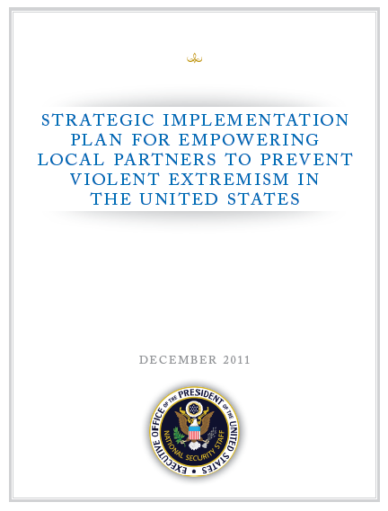
Countering Violent Extremism
Empower Communities
Share threat information
Strengthen cooperation with law enforcement
Help communities protect themselves
  Grassroots Narratives
  Limit recruits

Slide 3
U
.
S
.
D
EPARTMENT
OF
H
OMELAND
S
ECURITY
SECRETARY
Executive
________________
Chief of Staff
Secretariat
DEPUTY SECRETARY
Military Advisor
MANAGEMENT
SCIENCE
&
NATIONAL PROTECTION
POLICY
LEGISLATIVE AFFAIRS
PUBLIC AFFAIRS
Under Secretary
TECHNOLOGY
&
PROGRAMS
Assistant Secretary
GENERAL COUNSEL
Assistant Secretary
Assistant Secretary
INSPECTOR GENERAL
Under Secretary
Under Secretary
Chief Financial
Officer
HEALTH AFFAIRS
INTELLIGENCE
OPERATIONS
CITIZENSHIP
&
CIVIL RIGHTS
&
CIVIL
COUNTERNARCOTICS
Assistant Secretary
/
& ANALYSIS
COORDINATION
IMMIGRATION
CHIEF PRIVACY
LIBERTIES
ENFORCEMENT
Chief Medical Officer
Under Secretary *
Director
SERVICES
OFFICER
Officer
Director
OMBUDSMAN
FEDERAL LAW
DOMESTIC NUCLEAR
NATIONAL
CYBER SECURITY
CENTER
ENFORCEMENT
DETECTION OFFICE
TRAINING CENTER
Director
Director
Director
TRANSPORTATION
SECURITY
U
.
S
.
CUSTOMS
&
BORDER
U
.
S
.
CITIZENSHIP
&
U
.
S
.
IMMIGRATION
&
U
.
S
.
SECRET SERVICE
FEDERAL EMERGENCY
U
.
S
.
COAST GUARD
ADMINISTRATION
PROTECTION
IMMIGRATION SERVICES
CUSTOMS ENFORCEMENT
Director
MANAGEMENT AGENCY
Commandant
Assistant Secretary
/
Commissioner
Director
Assistant Secretary
Administrator
Administrator
* Under Secretary for Intelligence & Analysis title created by Public Law 110-53, Aug. 3rd, 2007
Approved 3/20/2008
Notes:
We are a small office with big impact:
Positioned under and report to Secretary
Our office is located in DC only; we do not have field offices
60 full- and part-time personnel as of now
Our staff is made up of supervisors, policy advisors, investigators, communications staff, administrative staff, contractors and seasonal interns.

Slide 4
DHS- Countering Violent Extremism
Better understand the behaviors and indicators of violent extremism
  Analysis (I&A, Policy)
  Research (S&T)
Support law enforcement and community oriented policing efforts
  Training (CT Coordinator, FLETC, CRCL)
  Grant Prioritization (FEMA)
Enhance partnerships with communities and law enforcement
  Community Engagement (CRCL, HSAC)
Notes:
First, we ENGAGE WITH THE PUBLIC
COMMUNITIES WHO may be affected by DHS programs and activities
Engage through “community roundtables” to demystify DHS:
Policies & Procedures
Redress avenues
Law enforcement participation where appropriate
Foster communication, understanding and respect for each other
EXAMPLE: Back in 2006-2008 when TSA was fine tuning its SOPs on the screening of religious headwear, our Engagement group met with Sikh and Muslim community leaders to hear concerns and talk about solutions did would not compromise security.
BUT we also engage internationally with government and community partners.
CRCL has collaborated with communities and government partners in the UK, Denmark, Norway, Finland, Germany, Spain, Pakistan, Turkey and Egypt, just to name a few.
We engage international partners on a variety of civil rights issues, including the hottest topic right now, countering violent extremism.
Have any of you heard of the White House’s Strategic Implementation Plan to Counter Violent Extremism? This is initiative with global reach, involving local, state, federal law enforcement, to mitigate radicalization within certain communities through community engagement.
Our efforts in this area have led us to:
Train State Department Foreign Service Officers as CVE officers. The State Department now has CVE officers at each post worldwide.
Host a CVE Exchange Delegation, where German officials exchanged places with DHS officials and participated in a CRCL roundtable, providing a different perspective.
Support the embassies’ efforts to counter violent extremism by including attaches in our international roundtables. YOU MAY HEAR FROM US.
Participate in the Transatlantic Pakistani Initiative. Pakistani communities from the U.S. and the U.K. Exchanged best practices on community engagement and mitigating radicalization.
Participate in the Resolution 16/18, a meeting on the Istanbul Process for Combating Intolerance, Discrimination, and Violence on the Basis of Religion or Belief.
We are collaborating with DOJ to develop education for country leaders on how to protect the religious rights and freedoms of their minority populations.

Slide 5
DHS Mission
To “ensure that civil rights and civil liberties of persons are not diminished by efforts, activities, and programs aimed at securing the homeland.” 6 U.S.C. § 111(b)(1)(G) Our Mission
The Department of Homeland Security Office for Civil Rights and Civil Liberties (CRCL) supports the Department’s mission to secure the Nation while preserving individual liberty, fairness, and equality under the law.
6 U.S.C. § 345; 42 U.S.C. § 2000ee-1
Notes:
We were established in 2003 to integrate and advance civil rights and civil liberties.
Our mission is to ensure individual liberty, fairness and equality under the law in all of DHS’s programs and activities worldwide.
There are four main services we provide DHS personnel (SKIP to slide 19).

Slide 6
We assist DHS colleagues through:
  Proactive Advice: We help the Department to shape policy in ways that are mindful of civil rights and civil liberties by providing proactive advice, evaluation and review of a wide range of technical, legal and policy issues.
  Public Complaint Resolution: We investigate and resolve complaints filed by the public regarding Departmental policies or actions taken by Departmental personnel.
  EEO Leadership: We provide leadership to the Department’s equal employment opportunity programs, seeking to make this Department the model federal agency.
  Engaging with the Public: Developing community oriented solutions to homeland security issues.
Notes:
First, we ENGAGE WITH THE PUBLIC
COMMUNITIES WHO may be affected by DHS programs and activities
Engage through “community roundtables” to demystify DHS:
Policies & Procedures
Redress avenues
Law enforcement participation where appropriate
Foster communication, understanding and respect for each other
EXAMPLE: Back in 2006-2008 when TSA was fine tuning its SOPs on the screening of religious headwear, our Engagement group met with Sikh and Muslim community leaders to hear concerns and talk about solutions did would not compromise security.
BUT we also engage internationally with government and community partners.
CRCL has collaborated with communities and government partners in the UK, Denmark, Norway, Finland, Germany, Spain, Pakistan, Turkey and Egypt, just to name a few.
We engage international partners on a variety of civil rights issues, including the hottest topic right now, countering violent extremism.
Have any of you heard of the White House’s Strategic Implementation Plan to Counter Violent Extremism? This is initiative with global reach, involving local, state, federal law enforcement, to mitigate radicalization within certain communities through community engagement.
Our efforts in this area have led us to:
Train State Department Foreign Service Officers as CVE officers. The State Department now has CVE officers at each post worldwide.
Host a CVE Exchange Delegation, where German officials exchanged places with DHS officials and participated in a CRCL roundtable, providing a different perspective.
Support the embassies’ efforts to counter violent extremism by including attaches in our international roundtables. YOU MAY HEAR FROM US.
Participate in the Transatlantic Pakistani Initiative. Pakistani communities from the U.S. and the U.K. Exchanged best practices on community engagement and mitigating radicalization.
Participate in the Resolution 16/18, a meeting on the Istanbul Process for Combating Intolerance, Discrimination, and Violence on the Basis of Religion or Belief.
We are collaborating with DOJ to develop education for country leaders on how to protect the religious rights and freedoms of their minority populations.

Slide 7
We assist DHS colleagues through:
  4. Engaging with the Public:
We communicate with individuals and communities whose civil rights and civil liberties may be affected by Department activities, informing them about policies and avenues of redress, and promoting appropriate attention within the Department to their experiences and concerns.
Notes:
First, we ENGAGE WITH THE PUBLIC
COMMUNITIES WHO may be affected by DHS programs and activities
Engage through “community roundtables” to demystify DHS:
Policies & Procedures
Redress avenues
Law enforcement participation where appropriate
Foster communication, understanding and respect for each other
EXAMPLE: Back in 2006-2008 when TSA was fine tuning its SOPs on the screening of religious headwear, our Engagement group met with Sikh and Muslim community leaders to hear concerns and talk about solutions did would not compromise security.
BUT we also engage internationally with government and community partners.
CRCL has collaborated with communities and government partners in the UK, Denmark, Norway, Finland, Germany, Spain, Pakistan, Turkey and Egypt, just to name a few.
We engage international partners on a variety of civil rights issues, including the hottest topic right now, countering violent extremism.
Have any of you heard of the White House’s Strategic Implementation Plan to Counter Violent Extremism? This is initiative with global reach, involving local, state, federal law enforcement, to mitigate radicalization within certain communities through community engagement.
Our efforts in this area have led us to:
Train State Department Foreign Service Officers as CVE officers. The State Department now has CVE officers at each post worldwide.
Host a CVE Exchange Delegation, where German officials exchanged places with DHS officials and participated in a CRCL roundtable, providing a different perspective.
Support the embassies’ efforts to counter violent extremism by including attaches in our international roundtables. YOU MAY HEAR FROM US.
Participate in the Transatlantic Pakistani Initiative. Pakistani communities from the U.S. and the U.K. Exchanged best practices on community engagement and mitigating radicalization.
Participate in the Resolution 16/18, a meeting on the Istanbul Process for Combating Intolerance, Discrimination, and Violence on the Basis of Religion or Belief.
We are collaborating with DOJ to develop education for country leaders on how to protect the religious rights and freedoms of their minority populations.

Slide 8
Why Civil Rights Community Engagement?
Public engagement with diverse communities whose civil rights and civil liberties may be affected by government activities is a priority.
Our Community Engagement Section responds to community concerns and provides information on DHS programs, activities, and issues by building trust and establishing a routine process for communication and coordination with diverse community leaders and organizations.

Slide 9
Community Engagement Goals
Communicate and share reliable information about Federal programs and policies, including avenues for redress and complaints;
Obtain information and feedback about community concerns and on-the-ground impacts of DHS activities;
Incorporate community ideas and issues relating to civil rights and civil liberties into the policymaking process;
Deepen channels of communication between communities, regional DHS leadership and other federal officials in order to facilitate solution of problems

Slide 10
Community Engagement Mechanisms

Slide 11


Slide 12
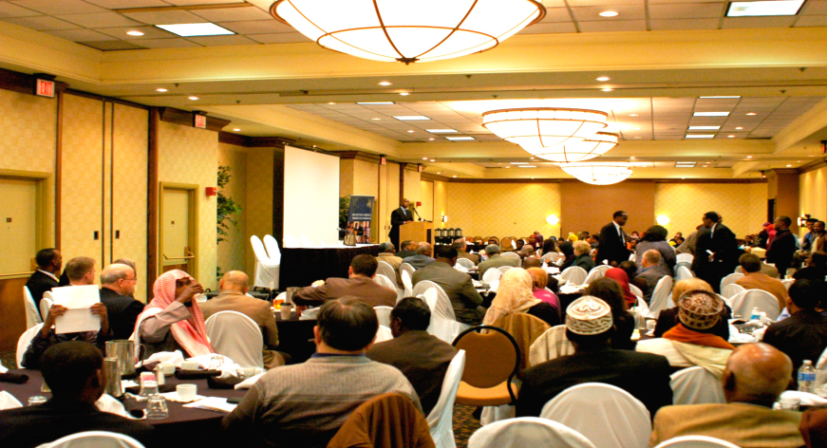
Subject-specific Community Events

Slide 13
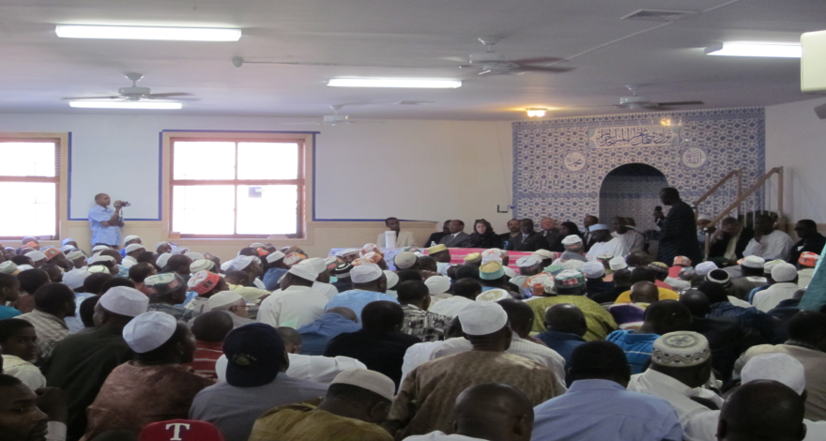
Faith Community Engagement

Slide 14

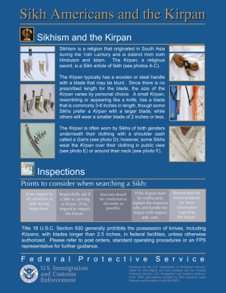
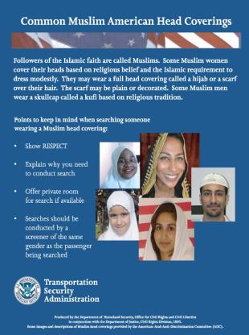
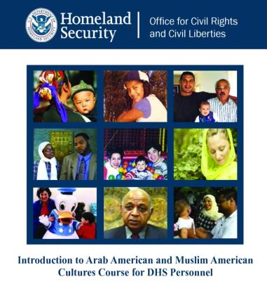
Community Policing/ Training

Slide 15
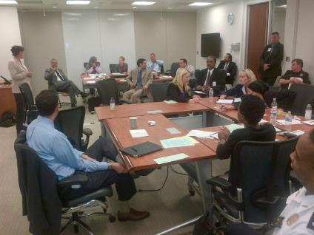
Countering Violent Extremism
Enhanced Engagement
Dialogue 2.0
Tabletop Exercises

Slide 16
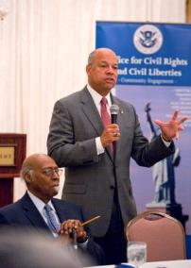
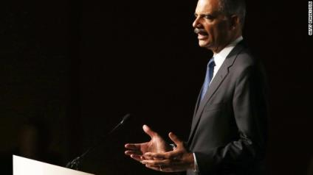
Foreign Fighters
Johnson said U.S. law-enforcement and intelligence officials know individuals from North America and Europe are heading to war-torn Syria, adding that “they will encounter radical, extremist influences” and possibly return to their home countries with the intent to do harm. “Syria has become a matter of homeland security,” Johnson said.
"In some ways, it's more frightening than anything I think I've seen as attorney general," he said. "This is a situation that we can see developing and the potential that I see coming up, the negative potential I see coming out of the facts in Syria and Iraq now, are quite concerning," he said.

Slide 17
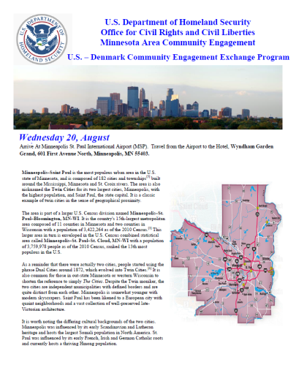
CVE EXCHANGE PROGRAMS

Slide 18
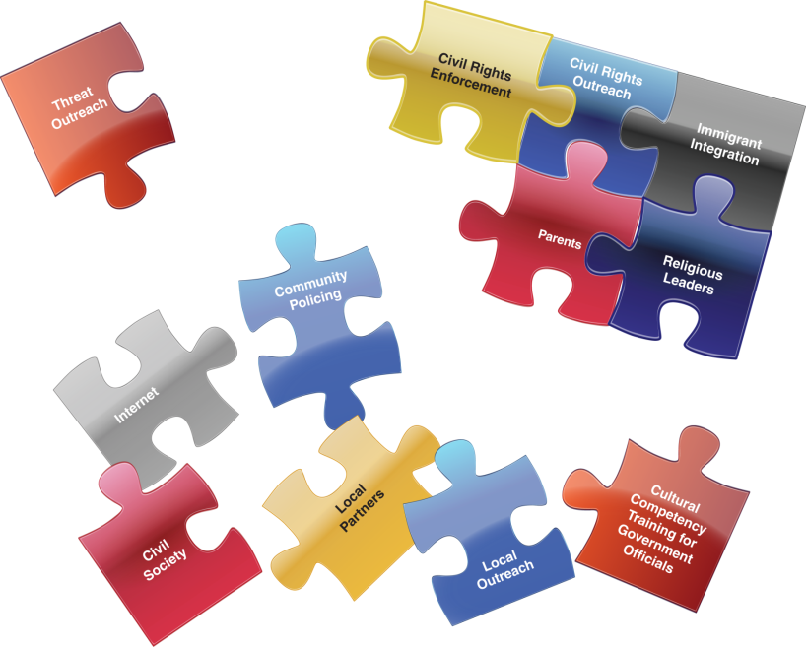
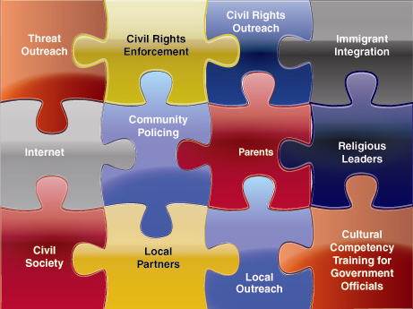
Responding to the Challenge:
How do we build safe and resilient communities?
Notes:
18

Slide 19
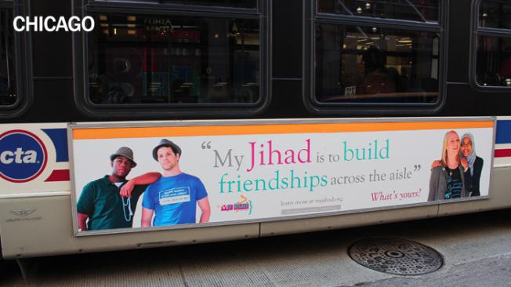

Changing the Narrative

Slide 20
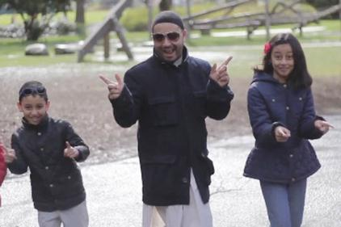
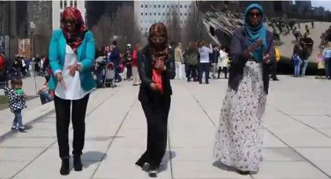
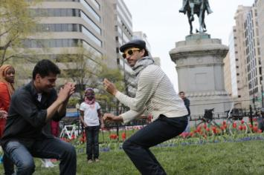
Changing the Narrative

Slide 21
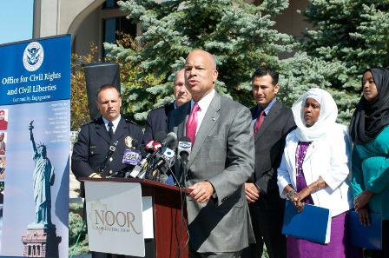
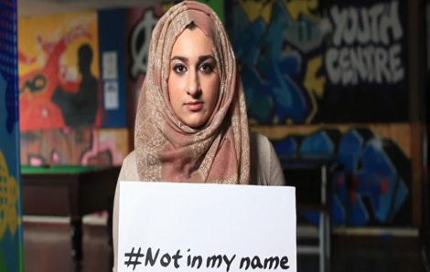
Changing the Narrative

Slide 22

Changing the Narrative

Slide 23
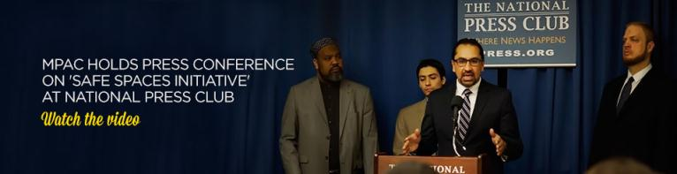
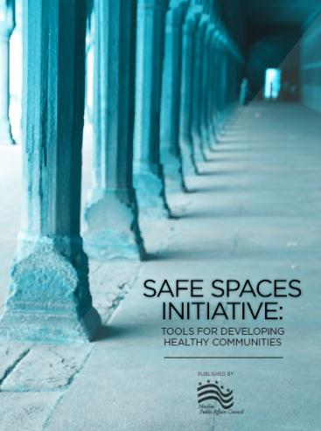
Life-Cycle of a Violent Extremist

Slide 24

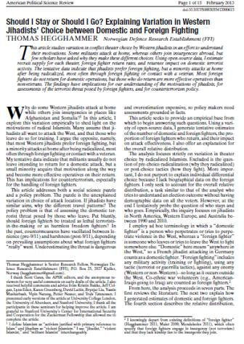
Syria Foreign Fighters

Slide 25
Myth
vs
Reality
Action & Adventure
Harsh Environment. Western fighters used to better living conditions
Embraced by the people
Syrian people don’t want foreigners’ help
Making a Difference
Used for undesirable tasks: suicide bombing, mechanical repair, cleaning
Defeating al-Assad
Not fighting al-Assad, rather fighting and targeting other Muslims/ minorities
One Global Community
There is much in-fighting among terrorist groups
Notes:
MYTH VS. REALITY
Created in cooperation with DHS, via research taken from International Centre for the Study of Radicalisation (http://icsr.info/)

Slide 26

Changing the Narrative

Slide 27
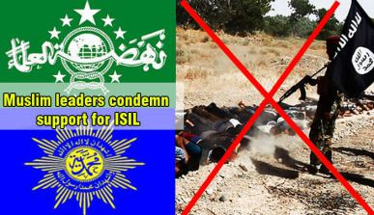
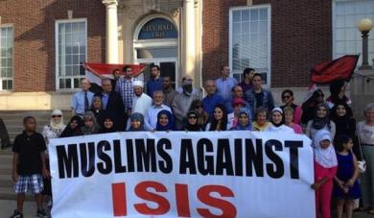
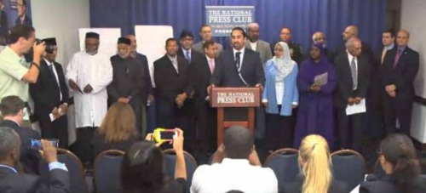
Condemning ISIS

Slide 28

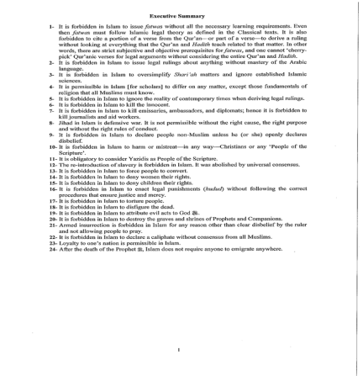
Condemning ISIS

