Slide 1
Immigrant economic contribution represents nearly
a quarter of the New York State economy
New York State GDP
in 2006: $1.02 trillion
Foreign-born
$229 billion
22.4%
U.S.-born
$791 billion
77.6%
Source: FPI calculation based on Bureau of Economic Analysis estimate of Gross
Domestic Product by State and ACS PUMS. See Working for a Better Life, Appendix B, for details.

Slide 2
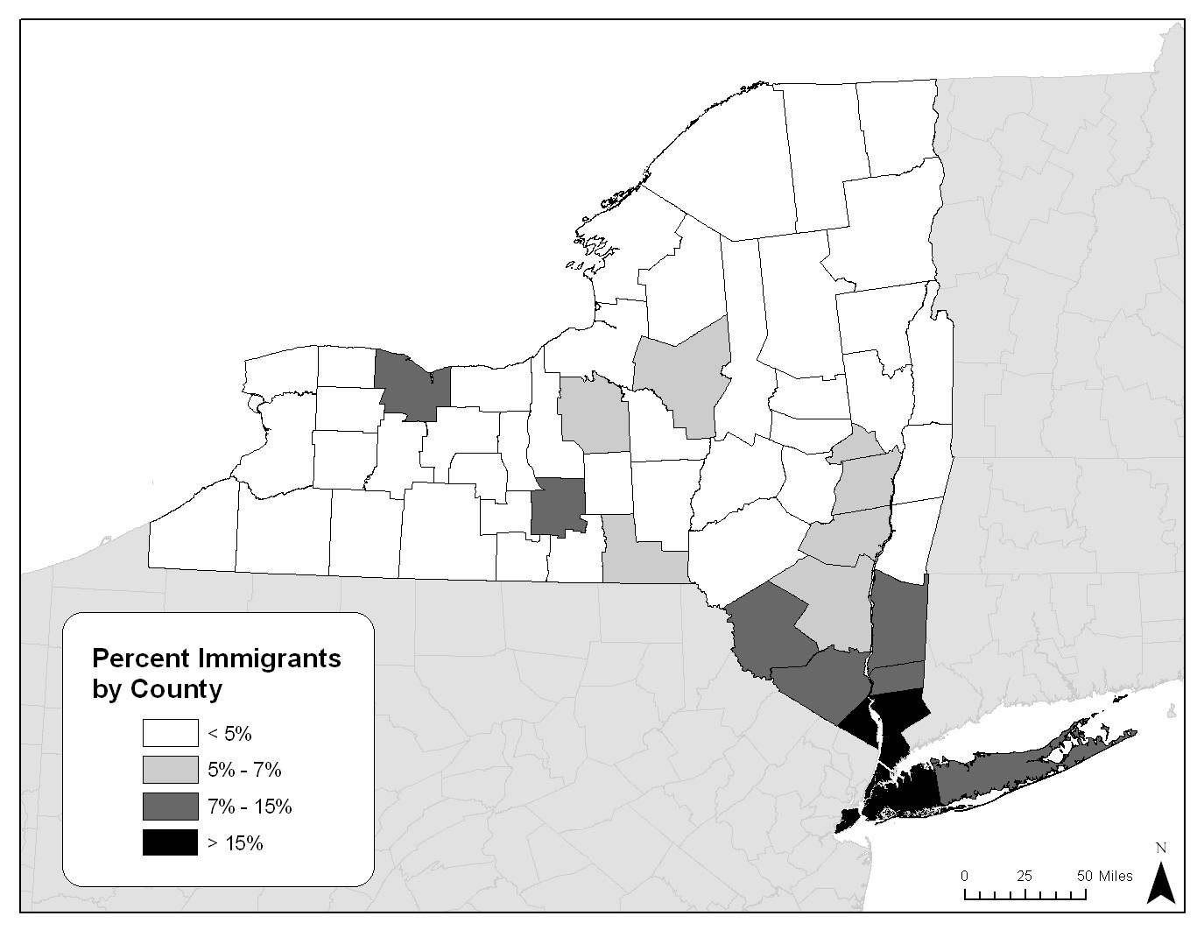
New York State
Immigration and growth go
hand in hand
Source: FPI analysis of 2000 Census microdata.
Map created by the Regional Plan Association.
Rochester
Ithaca
Hudson Valley
Downstate
Suburbs
New York City

Slide 3
Immigrant share of population is in line with
immigrant share of economic output
Source: Fiscal Policy Institute: Working for a Better Life.

Slide 4
Immigrant contributions make up
almost half of the New York City economy
Sources: FPI analysis of ACS PUMS, and New York City Department of City Planning.
Working age is 16-64 years old.

Slide 5
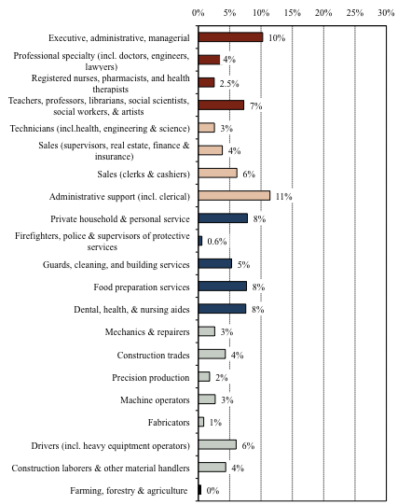
Managerial & professional
Immigrants work in jobs across the spectrum of the NYC economy
Tech, sales, & admin. support
Service jobs
Blue-collar jobs
Source: Fiscal Policy Institute analysis of 2005-07 American Community Survey.

Slide 6
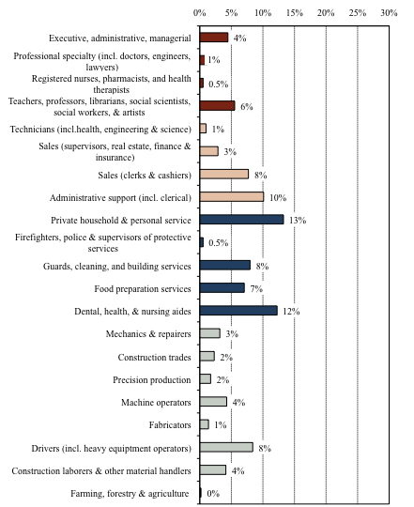
Managerial & professional
Dominican-born
immigrants in New York City
Tech, sales, & admin. support
Service jobs
Blue-collar jobs
Source: Fiscal Policy Institute analysis of 2005-07 American Community Survey.

Slide 7
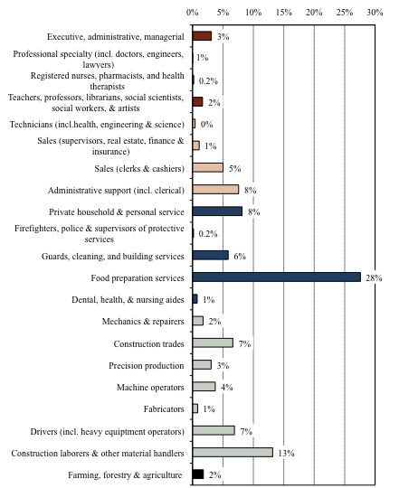
Managerial & professional
Mexican-born
immigrants in New York City
Tech, sales, & admin. support
Service jobs
Blue-collar jobs
Source: Fiscal Policy Institute analysis of 2005-07 American Community Survey.

Slide 8
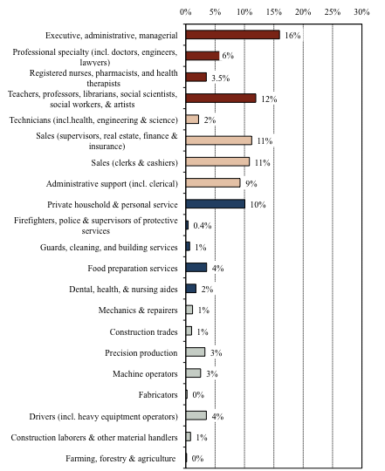
Managerial & professional
Korean-born
immigrants in New York City
Tech, sales, & admin. support
Service jobs
Blue-collar jobs
Source: Fiscal Policy Institute analysis of 2005-07 American Community Survey.

Slide 9
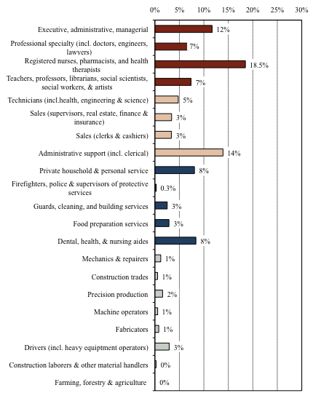
Managerial & professional
Russian-born
immigrants in New York City
Tech, sales, & admin. support
Service jobs
Blue-collar jobs
Source: Fiscal Policy Institute analysis of 2005-07 American Community Survey.

Slide 10
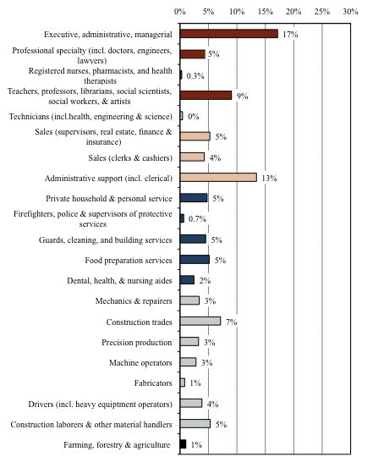
Managerial & professional
Trinidad & Tobago-born
immigrants in New York City
Tech, sales, & admin. support
Service jobs
Blue-collar jobs
Source: Fiscal Policy Institute analysis of 2005-07 American Community Survey.

Slide 11
Different groups of immigrants are concentrated in different occupations
blue-collar, service, and all other combined
white-collar
Source: Fiscal Policy Institute analysis of 2005-07 American Community Survey.

Slide 12
Share of total income accruing to the top one percent of tax filers

Slide 13
Share of total income accruing to the top one percent of tax filers

Slide 14
Share of total income accruing to the top one percent of tax filers

Slide 15
Share of total income accruing to the top one percent of tax filers

Slide 16
Share of total income accruing to the top one percent of tax filers

Slide 17
Share of total income accruing to the top one percent of tax filers
New York City

Slide 18
Immigrants have slightly lower poverty rates, but poverty levels are appallingly high for all, with great discrepancy between race/ethnic groups
Source: FPI analysis of 2005-07 ACS.
…even before the recent economic downturn. And rates are even higher in upstate cities.

Slide 19
300,000 more low-wage jobs in 2007 than in 1990, with immigrants more likely to be in low-wage jobs, and again big race/ethnic disparities
Share of full-time workers in low-wage jobs
Low wage = 2/3 of median ($27,000)
2005-07
28 percent of all full-time workers are in low-wage jobs

Slide 20
There are also widespread labor law violations that are more prevalent among immigrants but also very common for minorities (including U.S.-born) and not trivial for whites
In NY, Chicago, and Los Angeles, among low-wage workers:
* 31 percent of workers subjected to legal violations
* 26 percent of legal immigrants
* 38 percent of undocumented immigrants
* 30 percent of blacks (most of them U.S.-born)
* 10 percent of whites (mostly U.S.-born)
Broken Laws, Unprotected Workers, Annette Bernhardt et al.

